Slide 1
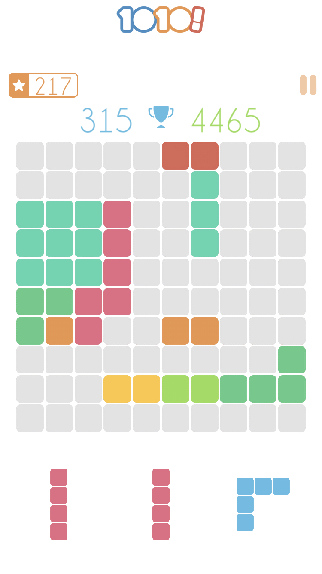
Rules of the game:
Every step of the game we receive 3 random pieces.
We should place these pieces one by one (no matter in which order) on the board. Every successfully placed piece increases the score and the goal is to achieve the highest score.
When the line or column is full, it disappears.
The game is over if you can’t place any of given pieces on the board (no free space).

Slide 2


Slide 3

HEURISTICS

Slide 4
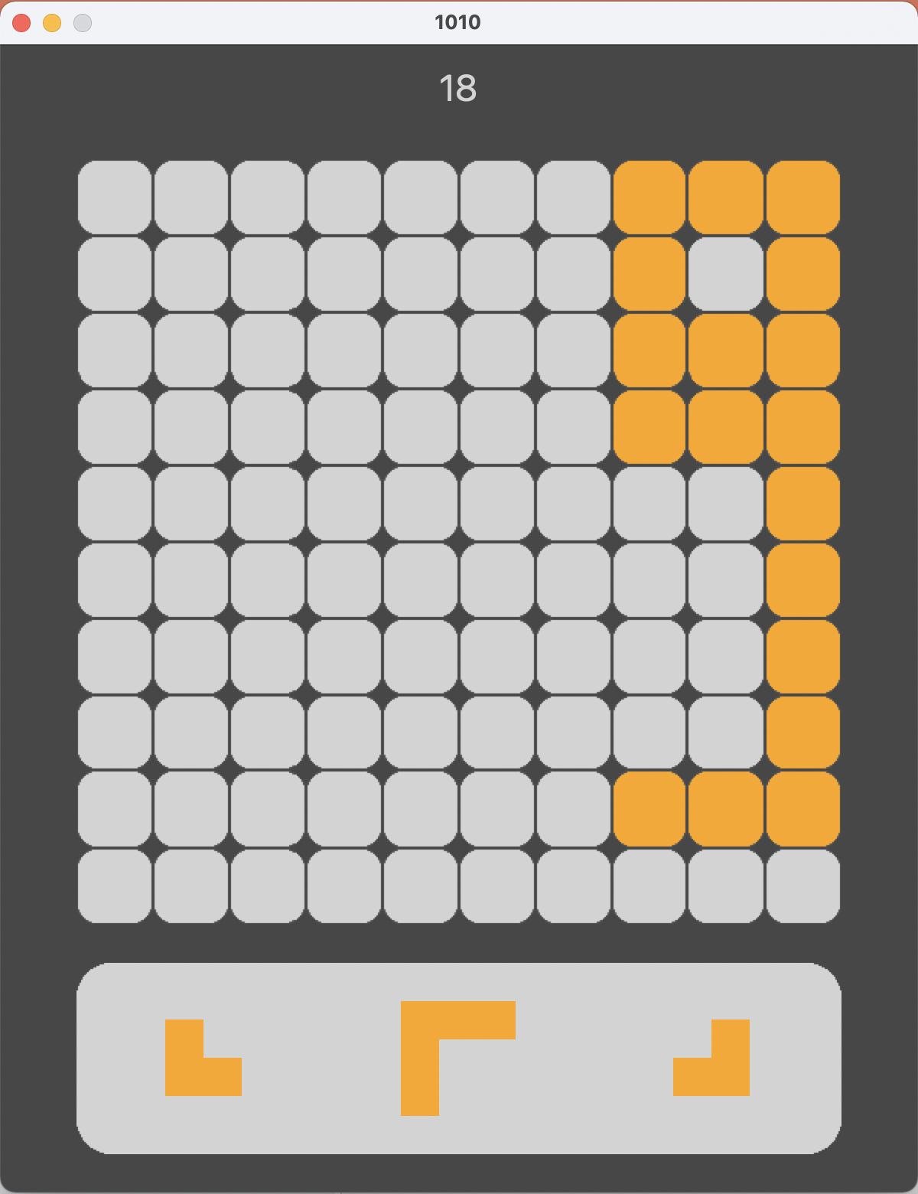

Slide 5
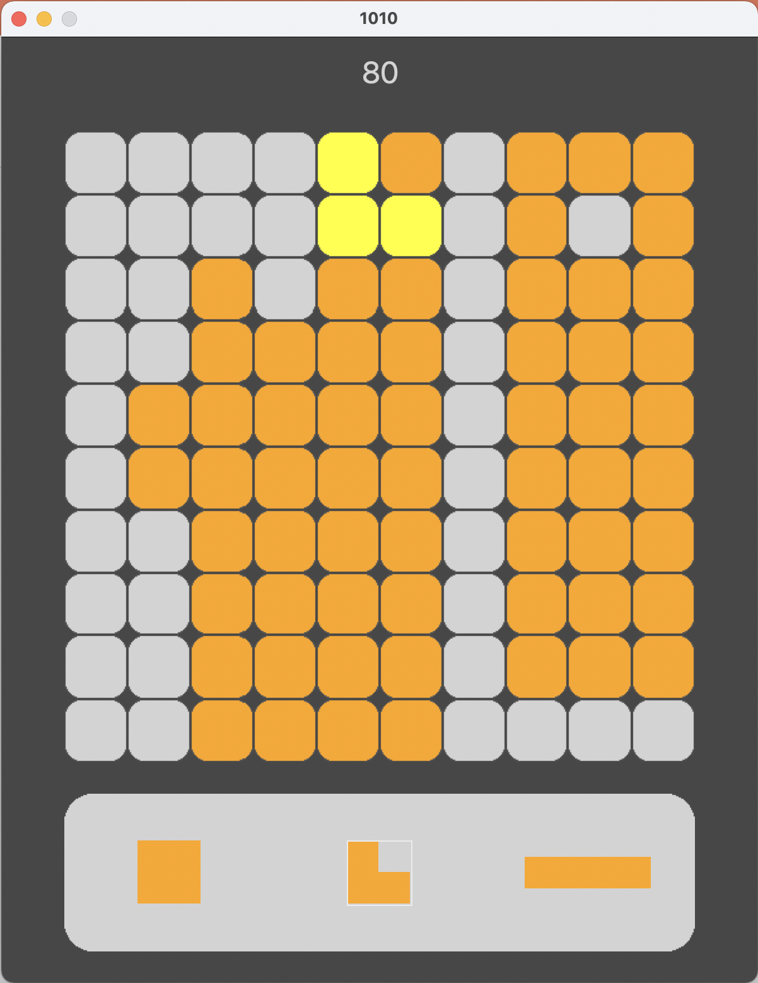
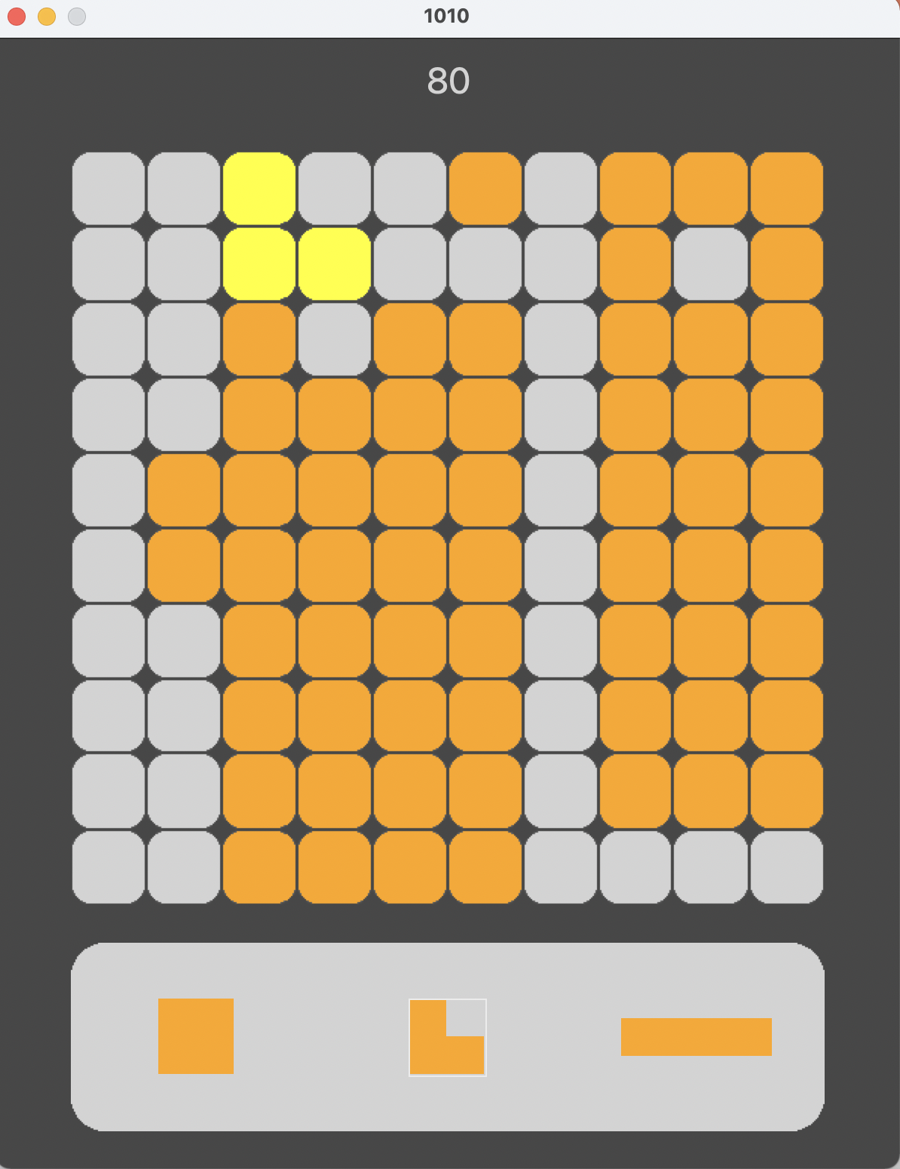

VS

Slide 6
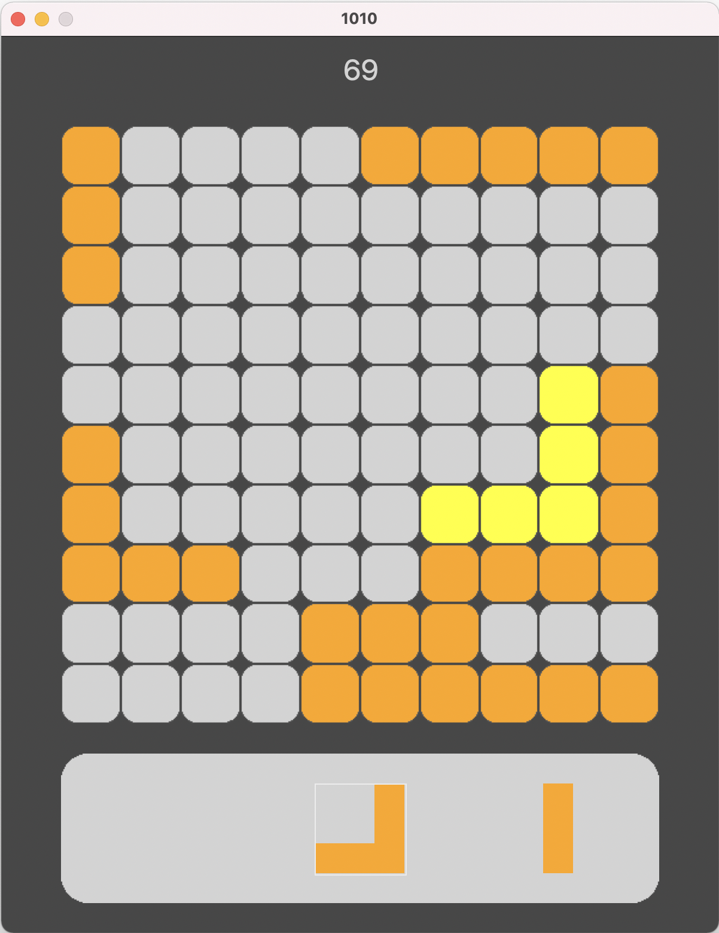
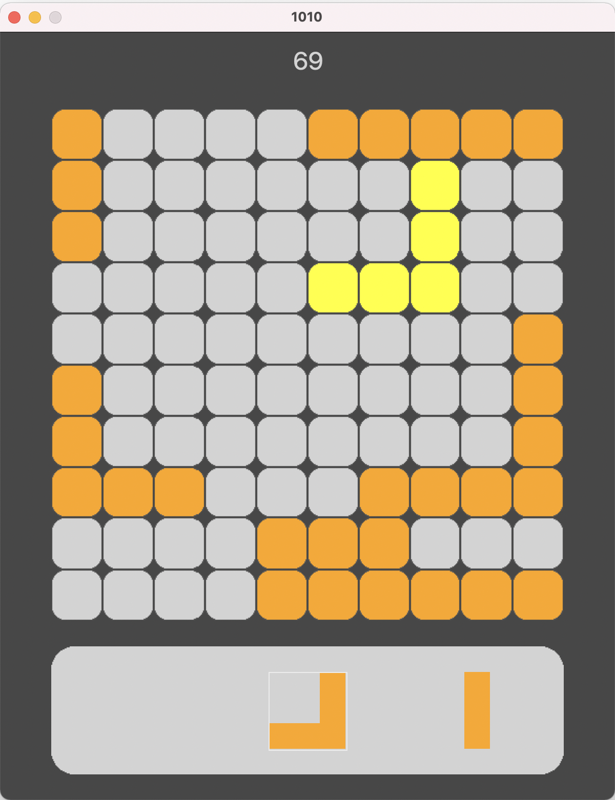
Surface = 6
Surface = 1
VS

Slide 7
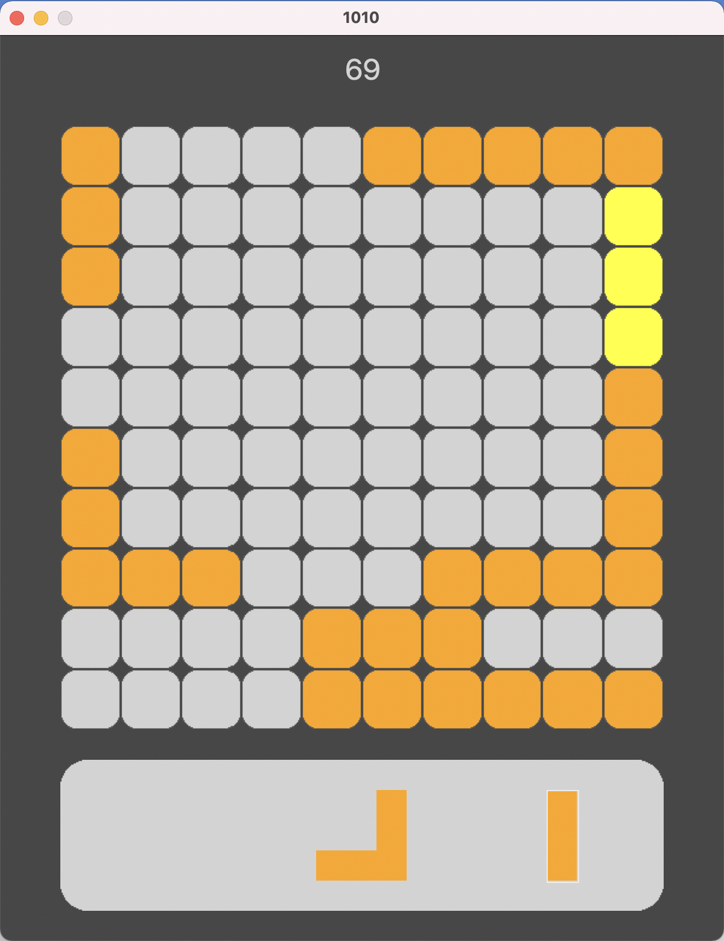
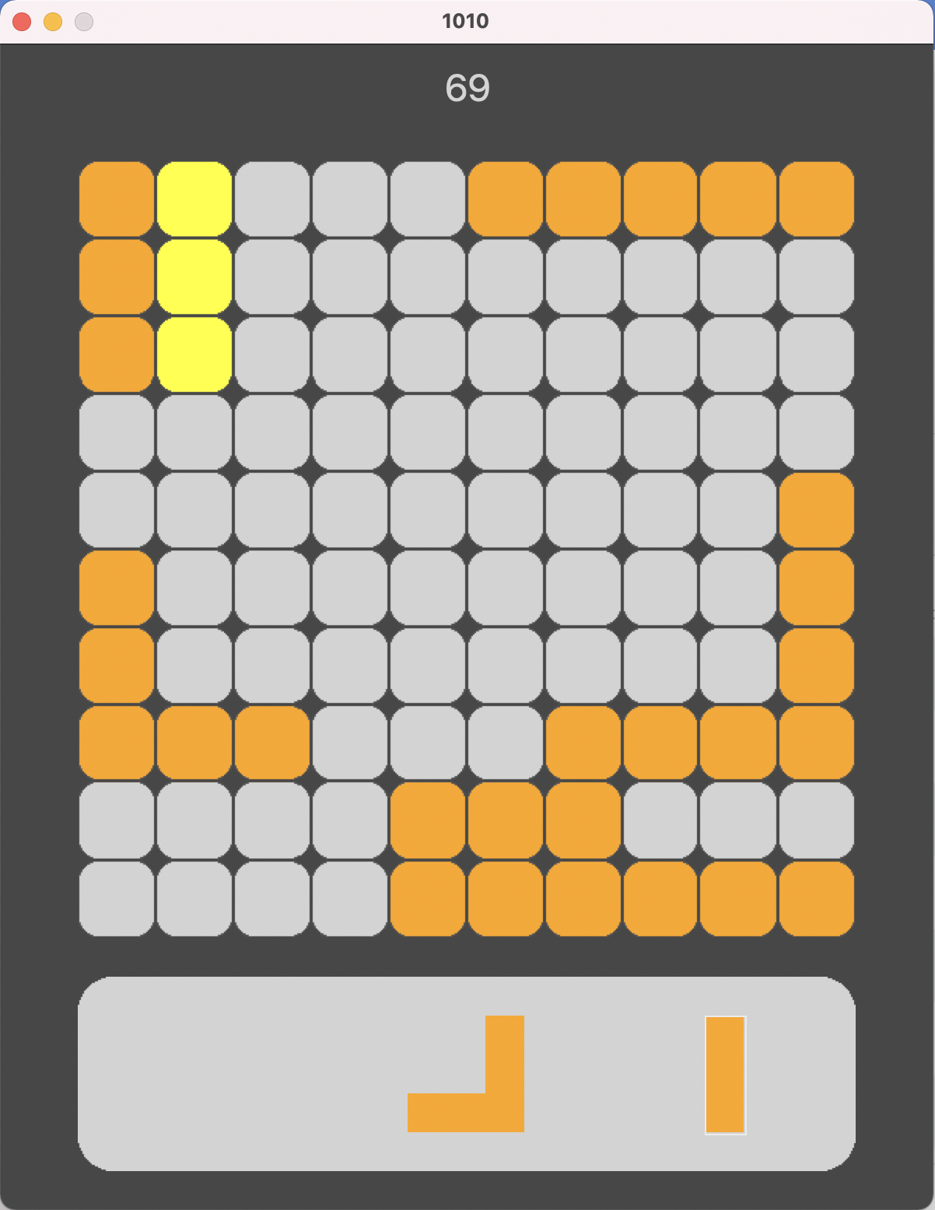
VS

Slide 8
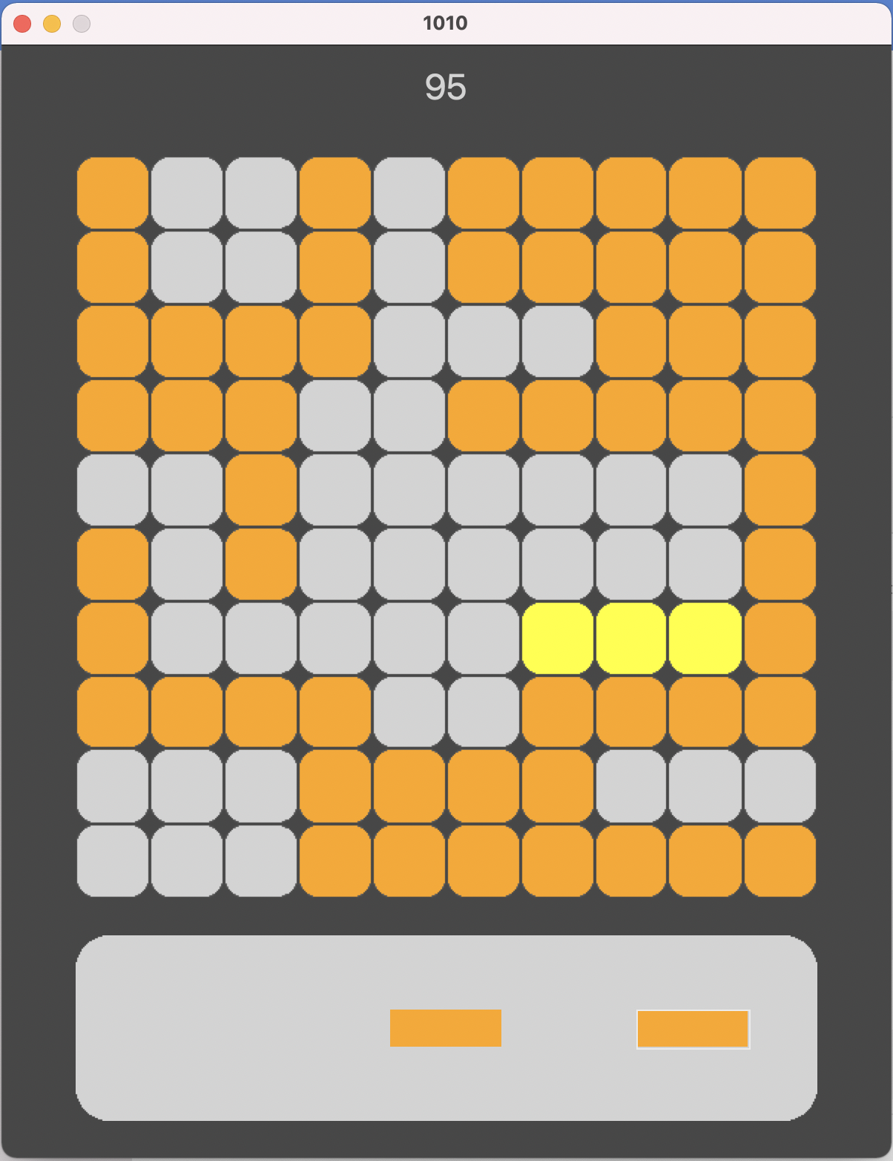
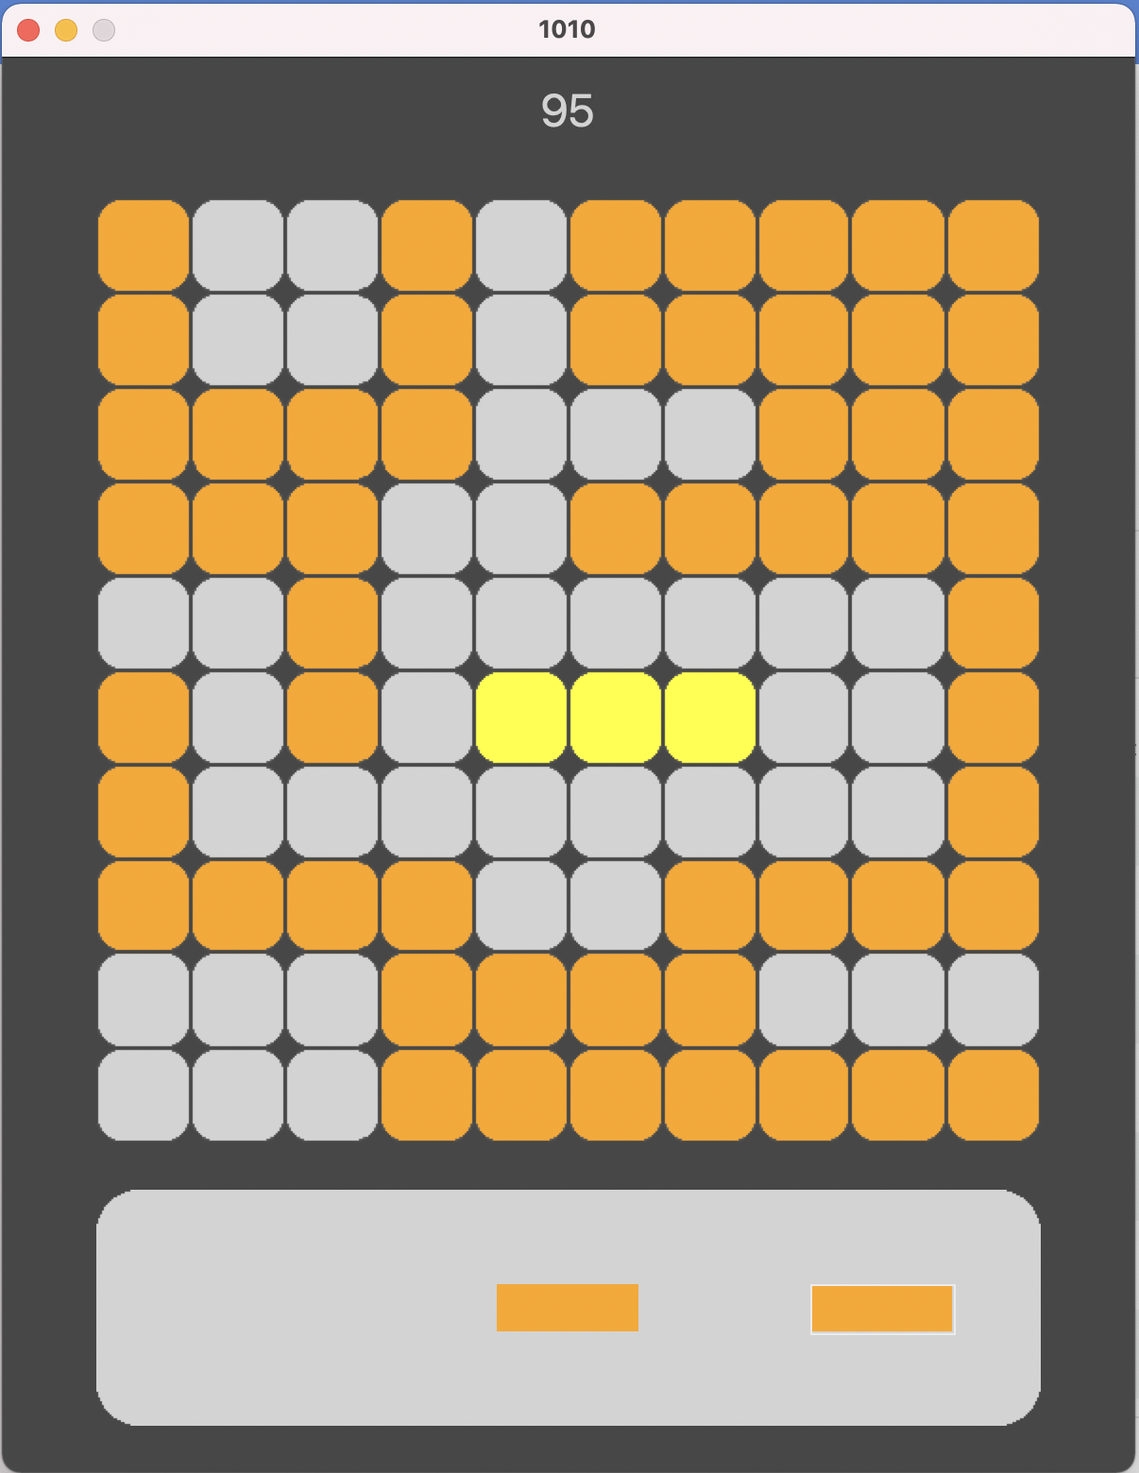
VS

Slide 9
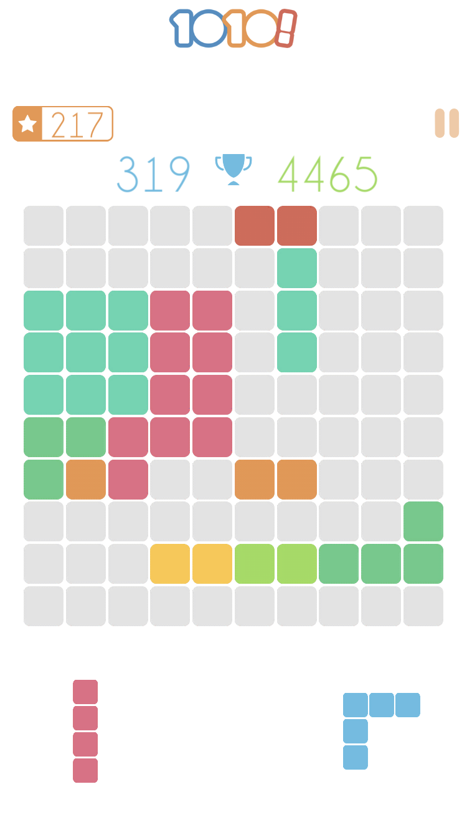
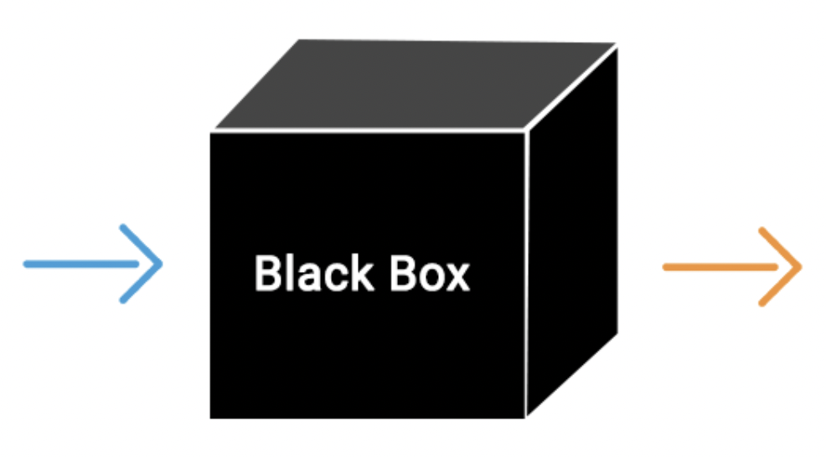
Greedy Best-First Search (single)
Best action for the piece is calculated according to heuristic values of all its possible assignments
Action choice is independent for each piece

Slide 10
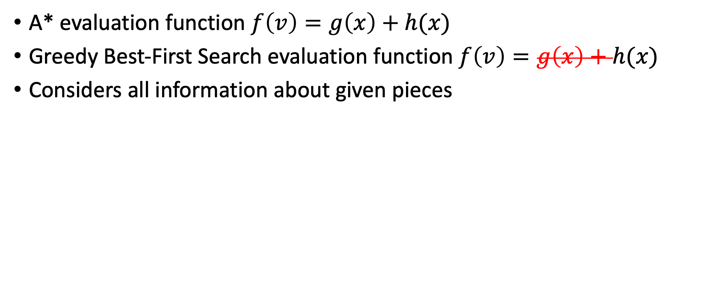
Greedy Best-First Search (triple)
A* evaluation function $f\left(v\right)=g\left(x\right)+h(x)$
Greedy Best-First Search evaluation function $f\left(v\right)=g\left(x\right)+h(x)$
Considers all information about given pieces

Slide 11

A ZERO-SUM GAME

Slide 12
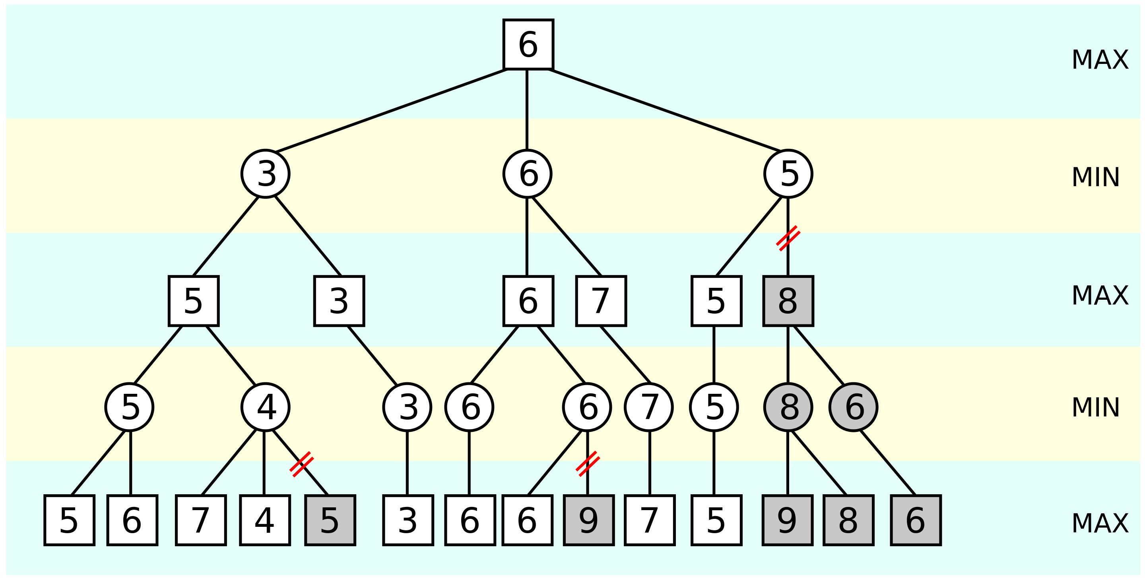
Alpha Betta pruning

Slide 13
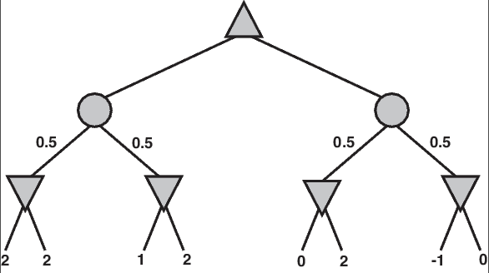
Expectimax

Slide 16
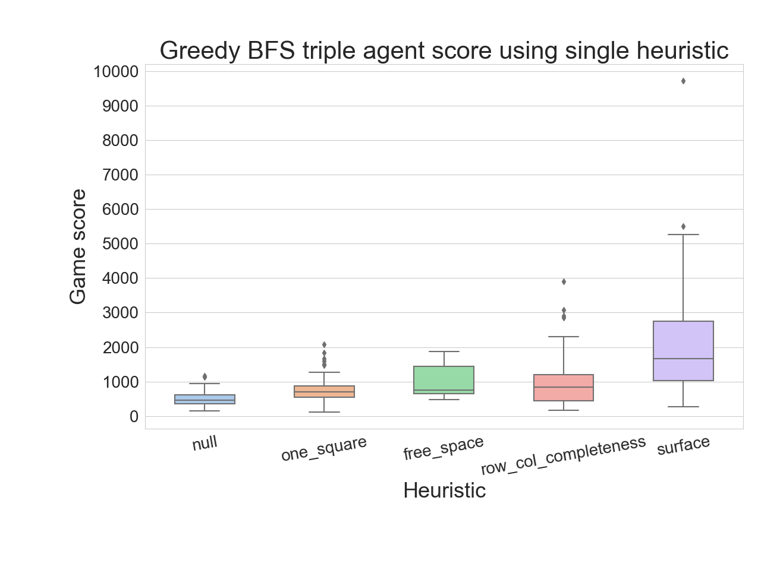

Slide 17
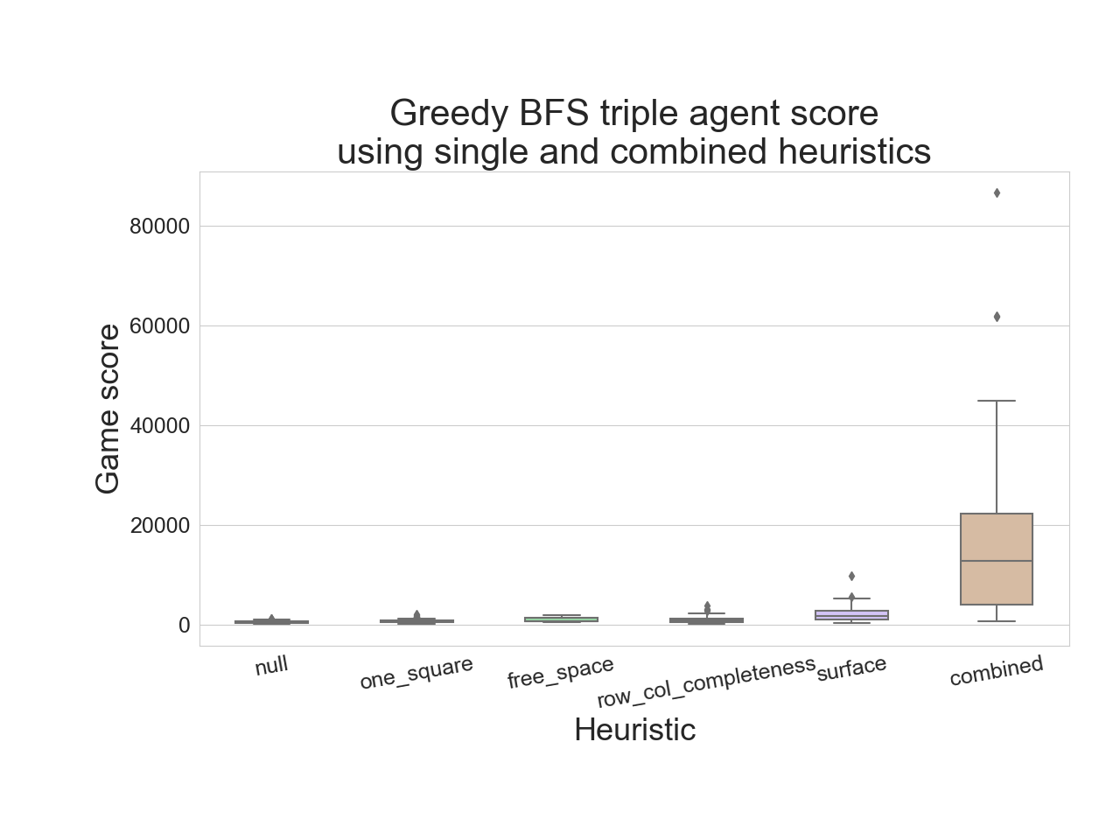

Slide 18
1 Slide for alpha-betta and expectimax score

Slide 19
2 Slide for alpha-betta and expectimax score

Slide 20
Time perfomance graph (for all methods)

Slide 21
